Slide 1
Neural Networks

Slide 2
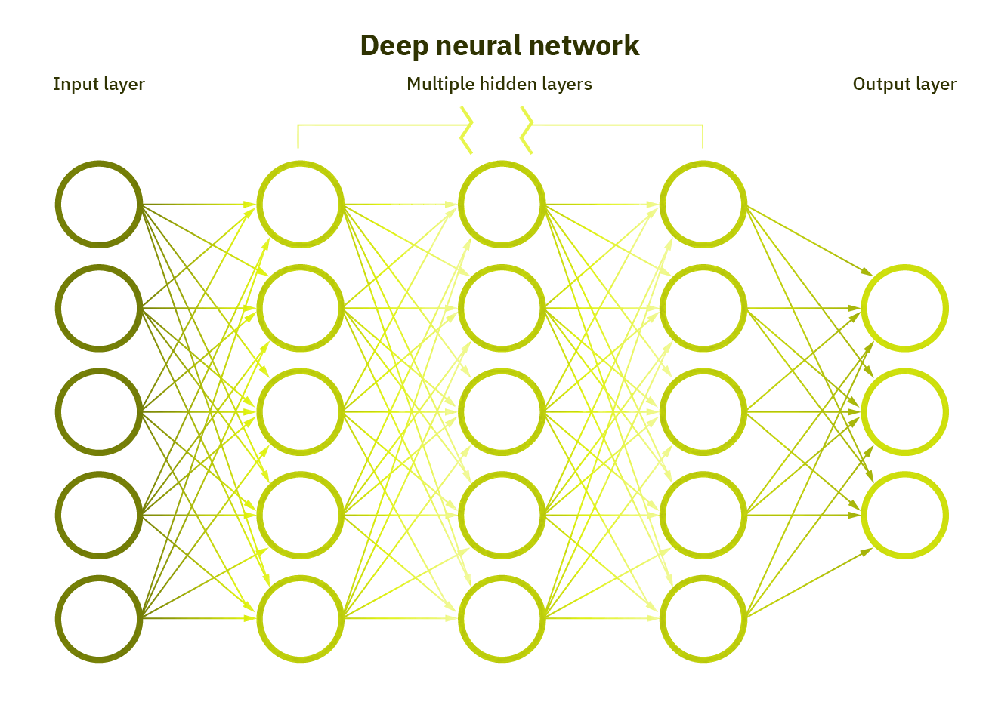
Elements of a Neural Network
Input Layer :- This layer accepts input features. It provides information from the outside world to the network, no computation is performed at this layer, nodes here just pass on the information(features) to the hidden layer.
Hidden Layer :- Nodes of this layer are not exposed to the outer world, they are the part of the abstraction provided by any neural network. Hidden layer performs all sort of computation on the features entered through the input layer and transfer the result to the output layer.
Output Layer :- This layer brings up the information learned by the network to the outer world.

Slide 3
Neural Networks
Neural networks are comprised of a node layers, containing an input layer, one or more hidden layers, and an output layer.
Each node, or artificial neuron, connects to another and has an associated weight and threshold. If the output of any individual node is above the specified threshold value, that node is activated, sending data to the next layer of the network. Otherwise, no data is passed along to the next layer of the network.

Slide 4

Neural Networks
Neural networks rely on training data to learn and improve their accuracy over time.
However, once these learning algorithms are fine-tuned for accuracy, they are powerful tools in computer science and artificial intelligence, allowing us to classify and cluster data at a high velocity.
Tasks in speech recognition or image recognition can take minutes versus hours when compared to the manual identification by human experts.
One of the most well-known neural networks is Google’s search algorithm.

Slide 5
Activation Function
Activation function decides, whether a neuron should be activated or not by calculating weighted sum and further adding bias with it. The purpose of the activation function is to introduce non-linearity into the output of a neuron.
We know, neural network has neurons that work in correspondence of weight, bias and their respective activation function. In a neural network, we would update the weights and biases of the neurons on the basis of the error at the output. This process is known as back-propagation. Activation functions make the back-propagation possible since the gradients are supplied along with the error to update the weights and biases.
An activation function has various variants, some of which are:

Slide 6
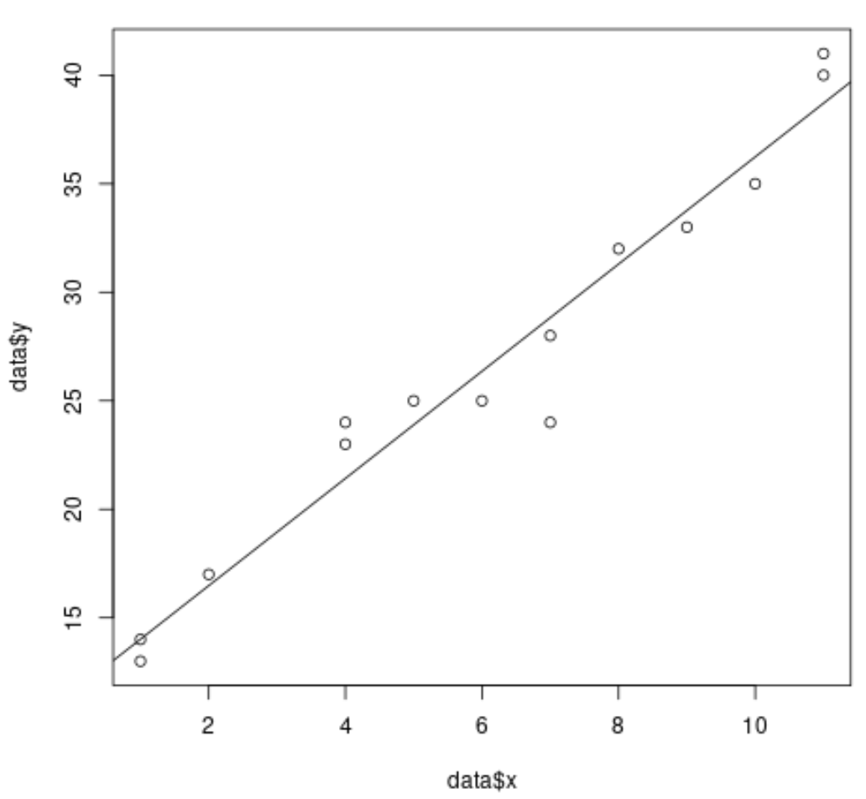
Activation Function
Linear Function :-
Equation : Linear function has the equation similar to as of a straight line i.e. y = ax
No matter how many layers we have, if all are linear in nature, the final activation function of last layer is nothing but just a linear function of the input of first layer.
Range : -inf to +inf
Uses : Linear activation function is used at just one place i.e. output layer.

Slide 7
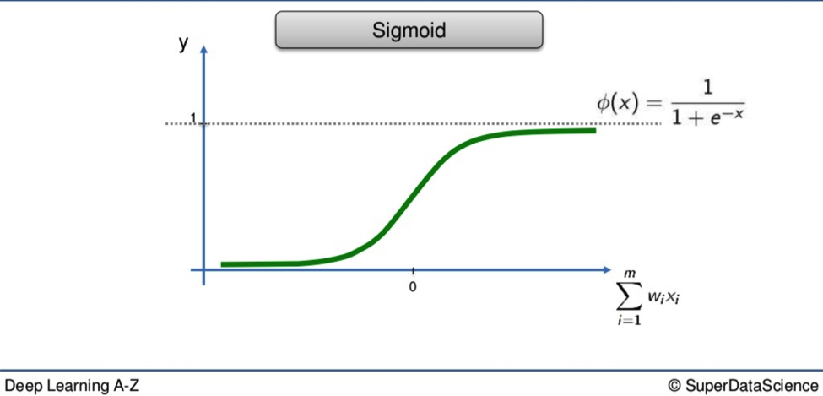
Activation Function
Sigmoid Function :-
It is a function which is plotted as ‘S’ shaped graph.
Equation : A = 1/(1 + e-x)
Nature : Non-linear. Notice that X values lies between -2 to 2, Y values are very steep. This means, small changes in x would also bring about large changes in the value of Y.
Value Range : 0 to 1
Uses : Usually used in output layer of a binary classification, where result is either 0 or 1, as value for sigmoid function lies between 0 and 1 only so, result can be predicted easily to be 1 if value is greater than 0.5 and 0 otherwise.

Slide 8
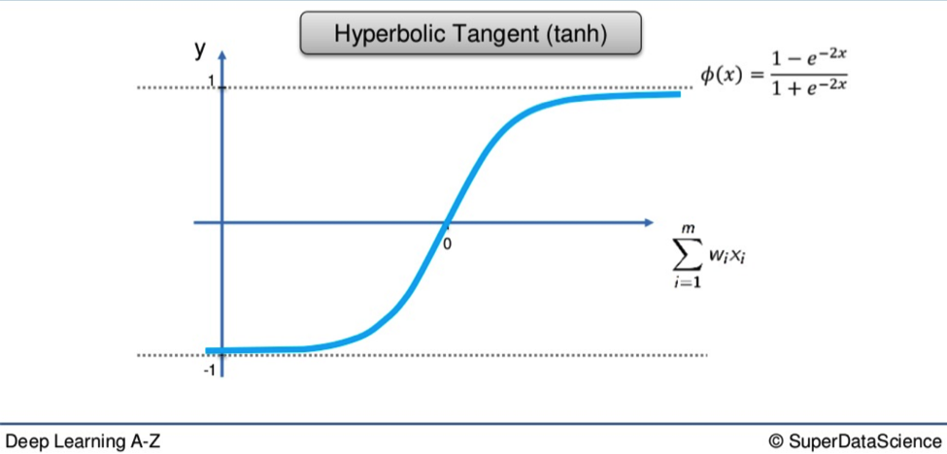
Activation Function
The activation that works almost always better than sigmoid function is Tanh function also known as Tangent Hyperbolic function. It’s actually mathematically shifted version of the sigmoid function. Both are similar and can be derived from each other.
Equation :- f(x) = tanh(x) = 2/(1 + e-2x) - 1
OR
tanh(x) = 2 * sigmoid(2x) - 1
Value Range :- -1 to +1
Nature :- non-linear
Uses :- Usually used in hidden layers of a neural network as it’s values lies between -1 to 1 hence the mean for the hidden layer comes out be 0 or very close to it, hence helps in centering the data by bringing mean close to 0. This makes learning for the next layer much easier.

Slide 9
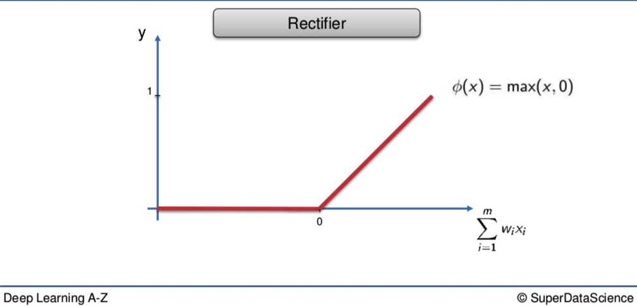
Activation Function
RELU :- Stands for Rectified linear unit. It is the most widely used activation function. Chiefly implemented in hidden layers of Neural network.
Equation :- A(x) = max(0,x). It gives an output x if x is positive and 0 otherwise.
Value Range :- [0, inf)
Nature :- non-linear, which means we can easily backpropagate the errors and have multiple layers of neurons being activated by the ReLU function.
Uses :- ReLu is less computationally expensive than tanh and sigmoid because it involves simpler mathematical operations. At a time only a few neurons are activated making the network sparse making it efficient and easy for computation.
In simple words, RELU learns much faster than sigmoid and Tanh function.

Slide 10
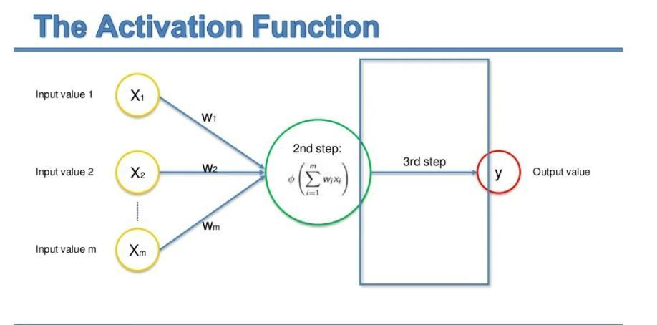
Forward Propagation

Slide 11
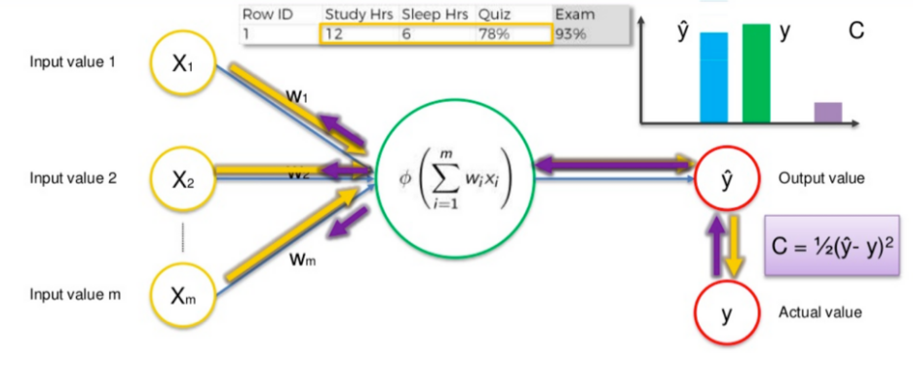
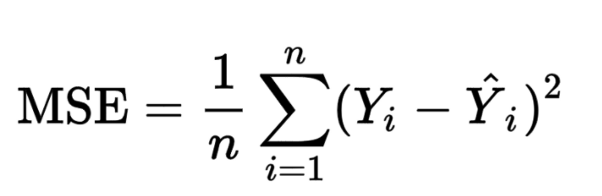
Backpropagation

Slide 12
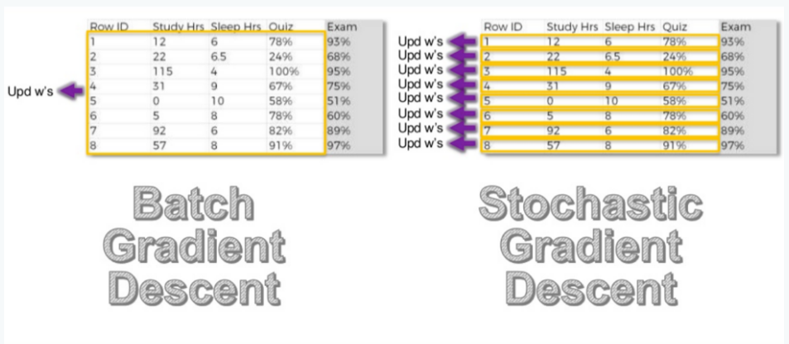
Batch and Stochastic Gradient Descent

Slide 13
Training an NN
STEP 1: Randomly initialize weights to small numbers close to 0 (but not 0).
STEP 2: Input the first observation of your dataset in the input layer, each feature in one input node.
STEP 3: Forward Propagation from left to right, the neurons are activated in a way that the impact
of each neuron’s activation is limited by the weights. Propagate the activations till you get the
predicted y.
STEP 4: Compare the predicted result to the actual result and calculate the error.
STEP 5: Backpropagation from right to left, the error is back propagated and the weights are
Updated according to how much they are responsible for the error.
STEP 6: Repeat steps 1 to 5 and update weights after each observation (stochastic Gradient Descent) or
Repeat steps 1 to 5 and update weights after a batch of observations (Batch Learning)
STEP 7: When the whole training set is passed through the NN, that makes an epoch. Redo more epochs.

Slide 14
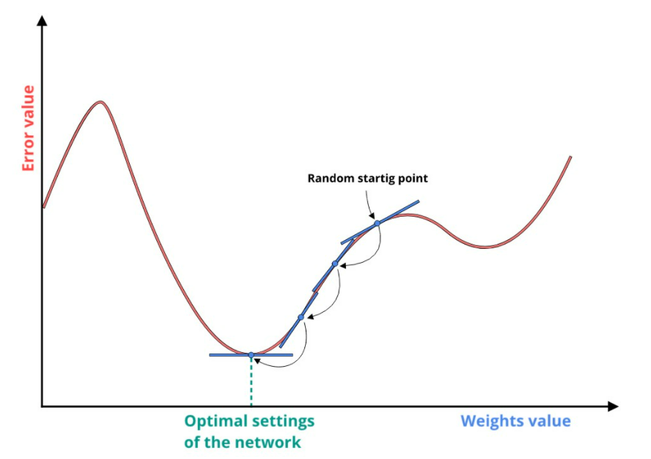
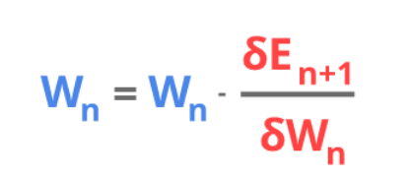
Gradient Descent

Slide 15
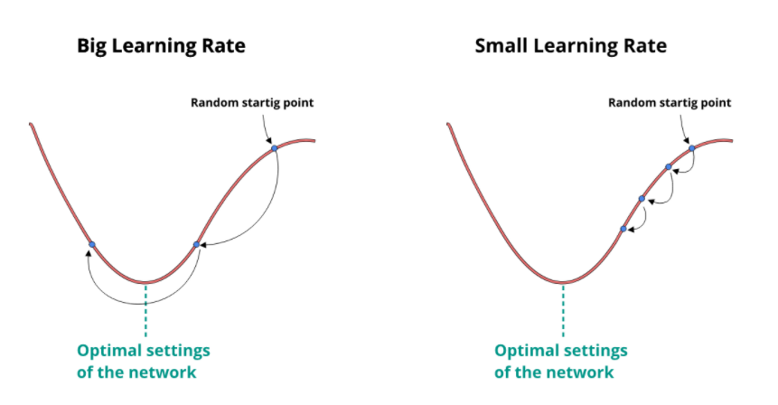
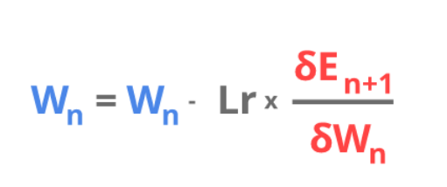
Learning Rate

